Slide 1
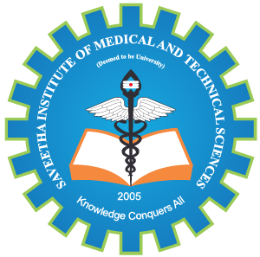
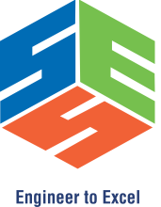
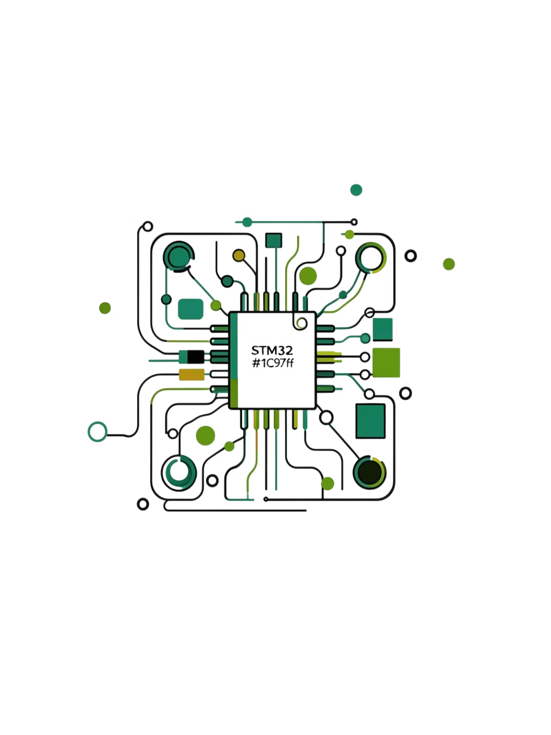
SIMATS ENGINEERING Saveetha Institute of Medical and Technical Sciences Chennai-602105
Development of a Compact STM32 Board Overcoming Conventional Dev Kit Limitations through Integrated Li-Ion Power Management, High-Efficiency DC-DC Conversion, and Optimized 2-Layer PCB Architecture
ABHINANDH K
[ 192312276 ]

Slide 2
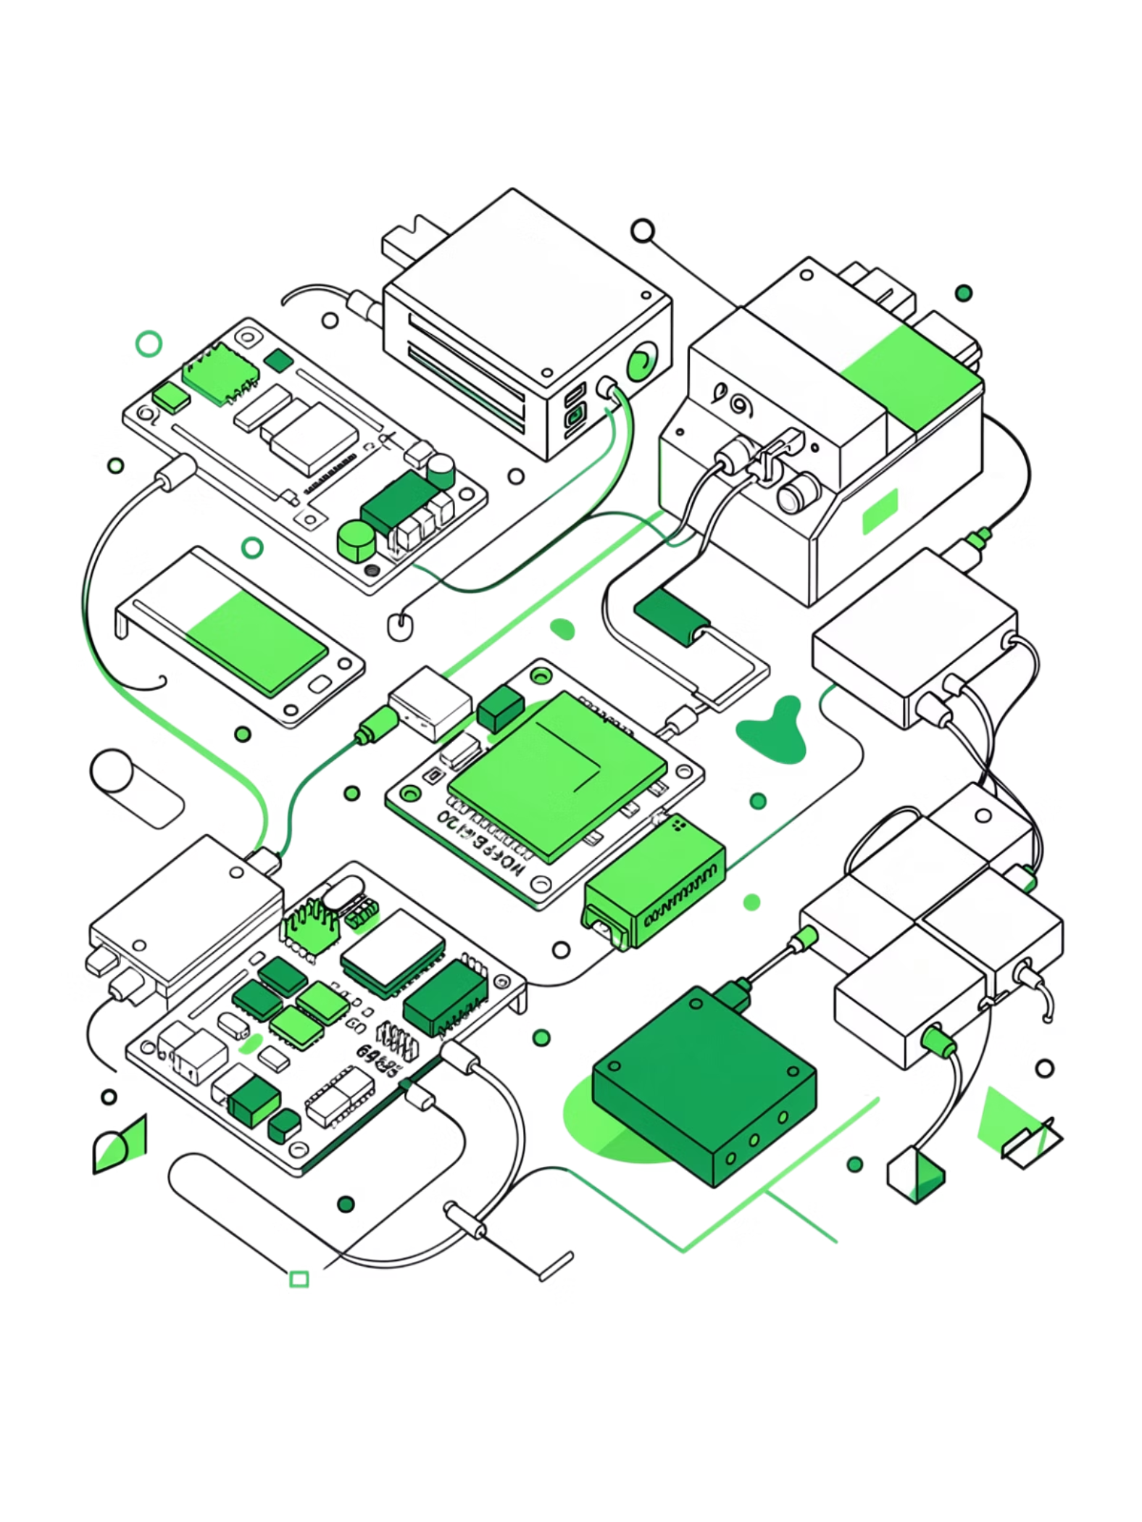
The Problem with Conventional Dev Kits
STM32 Nucleo and Discovery boards are excellent for prototyping — but they fall short when it's time to ship a product. Bulky form factors, external power modules, and no battery integration make them impractical for real-world deployment.

Slide 3
Why This Custom Board
Integrated System Design
No External Modules
Eliminates the TP4056, boost converters, and wiring that clutter dev kit setups.
Power management, battery charging, and MCU all on a single PCB — no external modules required.
Real-World Ready
Designed for deployment, not just evaluation — compact, efficient, and self-contained.

Slide 4
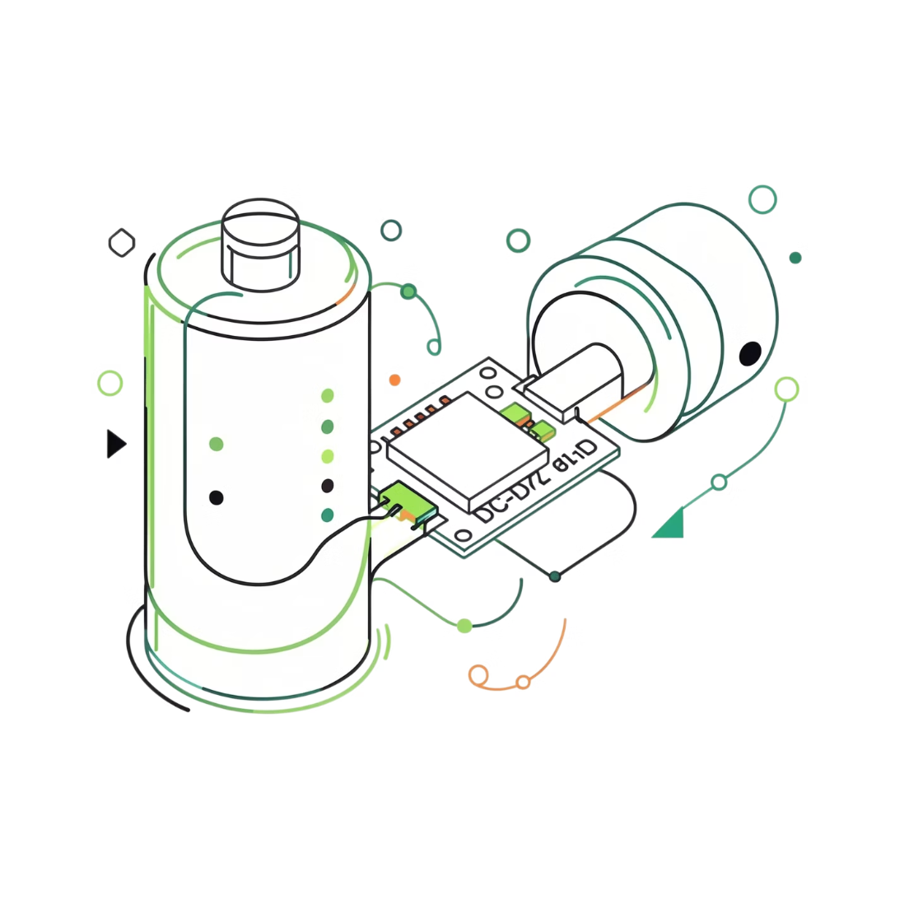
Key Features & Advantages
Li-Ion Battery Support
DC-DC Power Conversion
Direct battery input with integrated charging circuitry — no separate charger module.
Efficient voltage regulation from battery to MCU supply rail.
Compact 2-Layer PCB
USB + SWD Programming
Minimal board footprint suitable for space-constrained enclosures.
Standard debug interface — no proprietary hardware needed.

Slide 5
Trade-offs to Consider
Every design decision involves compromise. Understanding the limitations helps set realistic expectations for this board's use cases.
Less Flexible Than Dev Kits
Hardware Debugging is Harder
2-Layer Routing Constraints
Fixed pinout and power architecture — not designed for rapid peripheral swapping.
Limited test points and a denser layout make probe access more challenging.
Power and signal routing must be carefully managed without a dedicated ground plane.

Slide 6
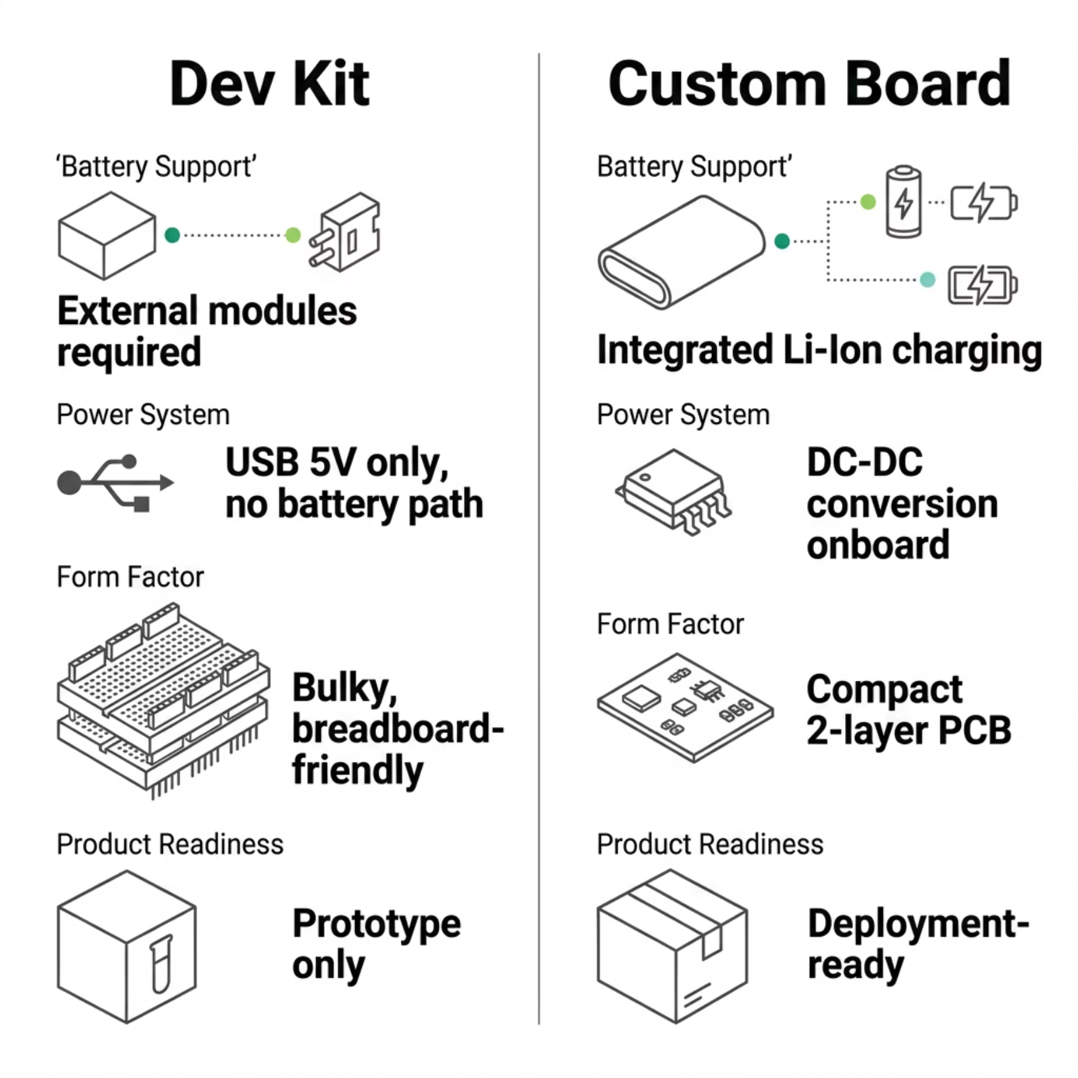

Dev Kit vs. Custom Board
When evaluating hardware for a product, the differences between a dev kit and a custom board become critical. This comparison highlights where each approach wins — and where it falls short.

Slide 7
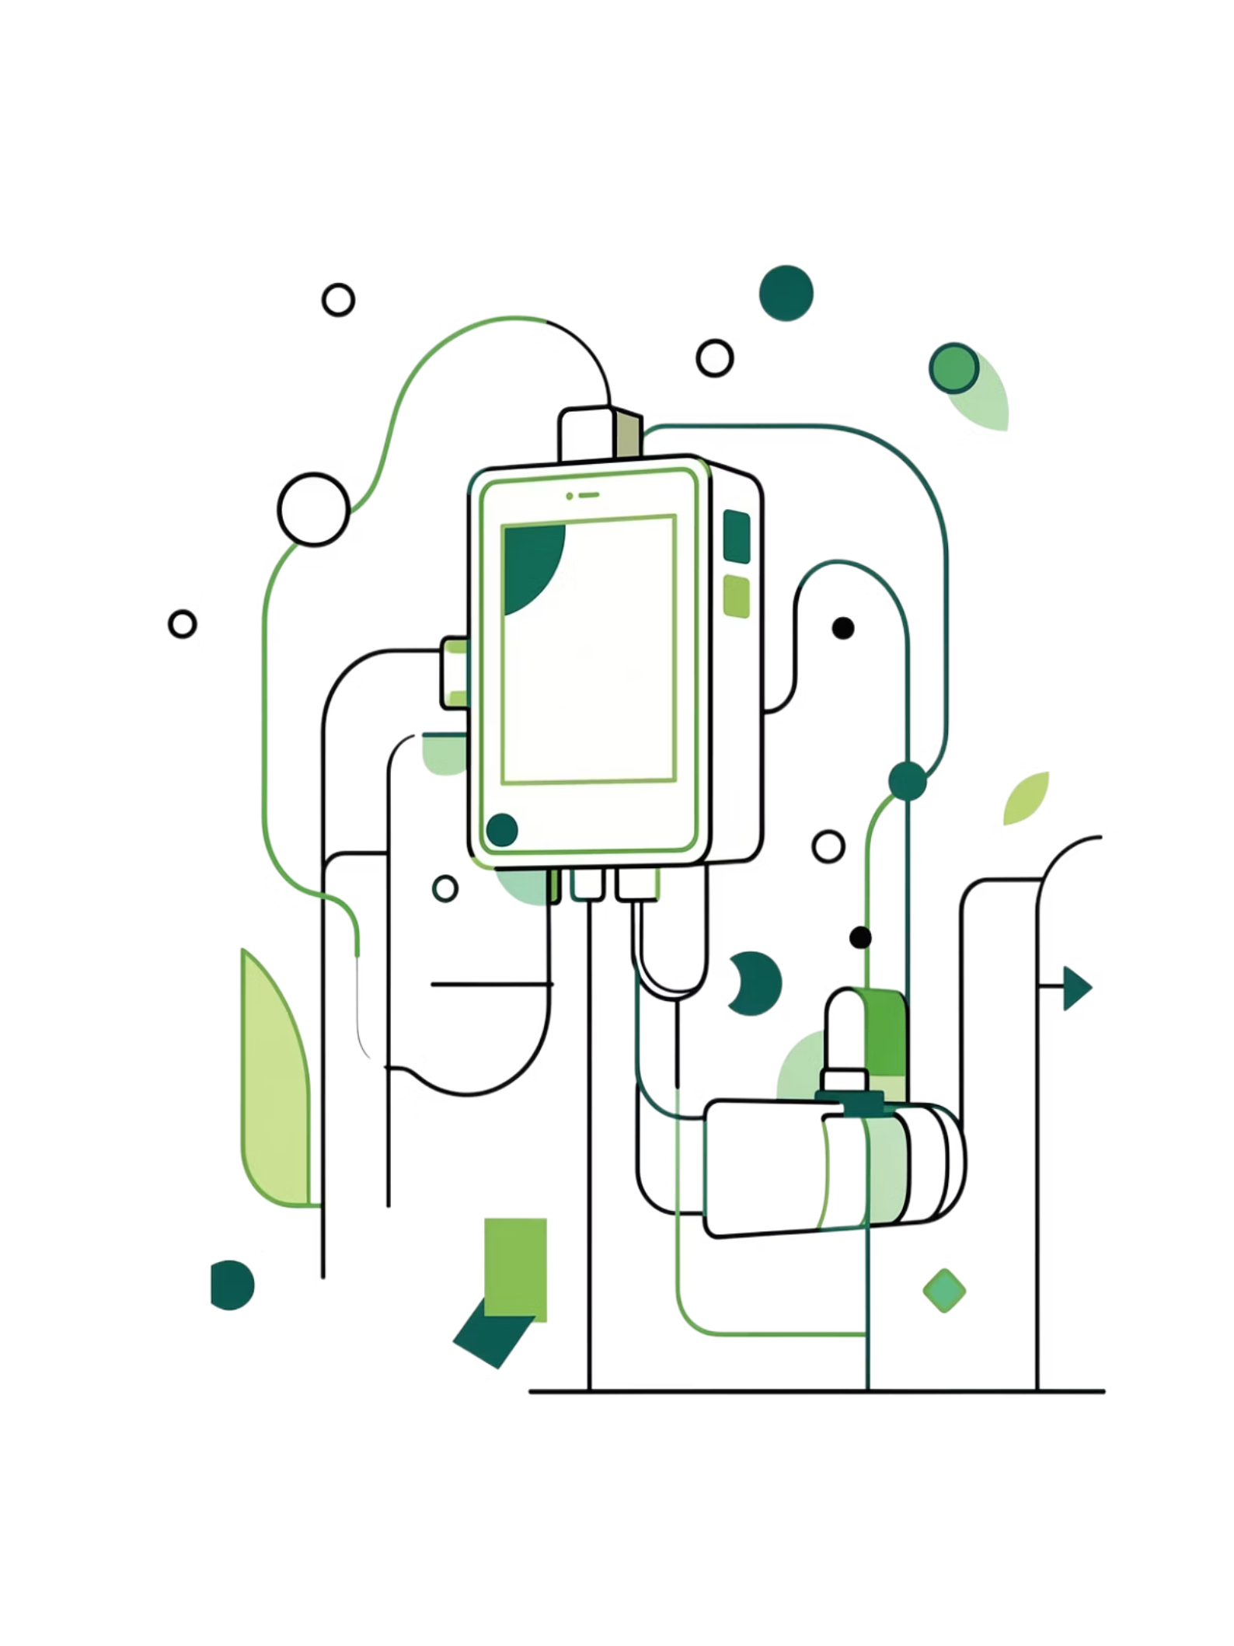
Target Applications
IoT Devices
Low-power wireless nodes with long battery life requirements.
Portable Systems
Handheld instruments, wearables, and field-deployable hardware.
Battery-Powered Electronics
Any embedded system requiring autonomous operation without wall power.
Industrial Monitoring
Remote sensors and data loggers in harsh or inaccessible environments.

Slide 8
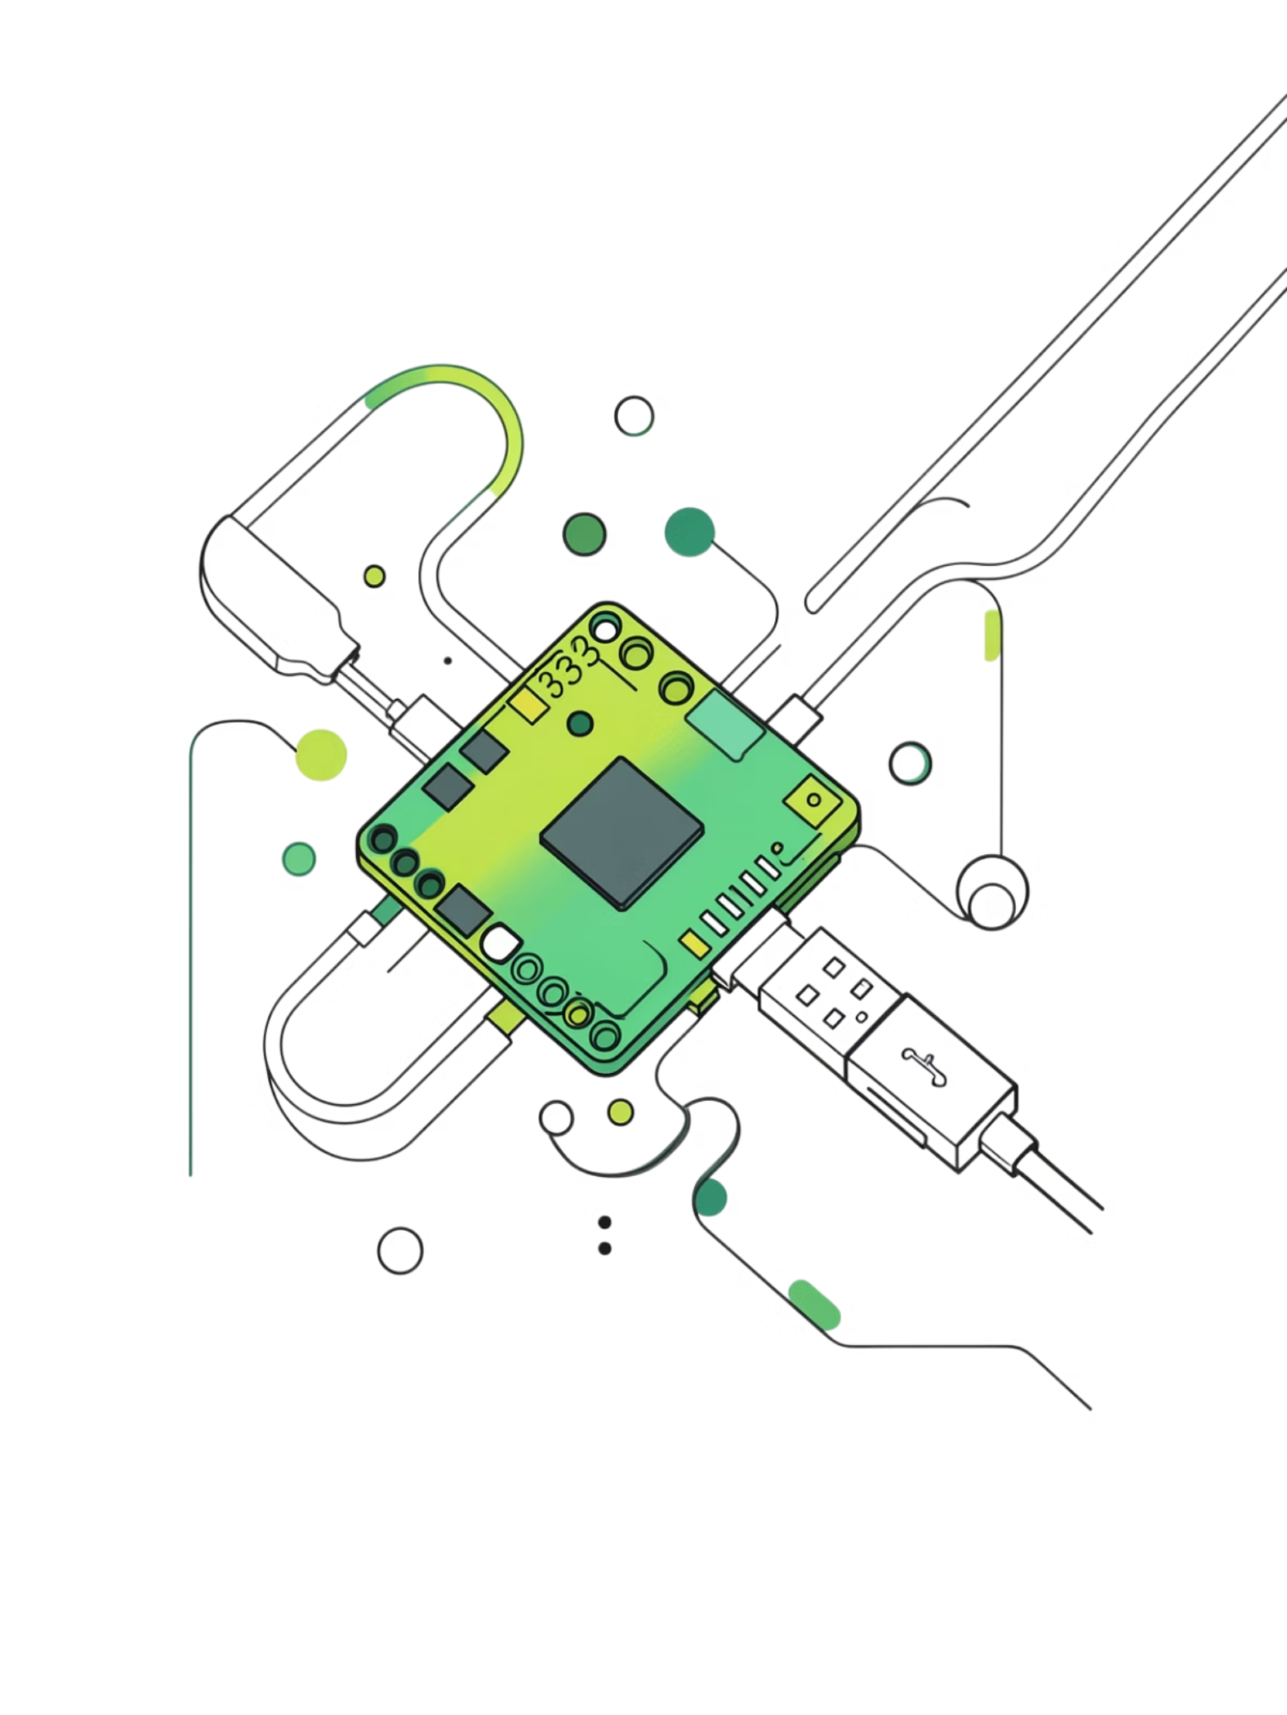
How Dev Boards Handle Power
1
USB 5V → 3.3V Regulator
Onboard LDO provides MCU supply from USB — simple, but USB-tethered.
2
External 5V Supported
Some boards accept external 5V input, but still lack battery management.
3
No Built-In Battery Charging
Li-Ion charging must be handled by an entirely separate module — adding cost, size, and complexity.

Slide 9

The Dev Board Battery Workaround
Battery
TP4056 Charger
Boost/Buck Converter
Dev Board
This multi-module chain is the standard approach for adding battery power to a Nucleo or Discovery board. Each stage introduces efficiency loss, additional wiring, and physical bulk — the opposite of a product-ready design.

Slide 10
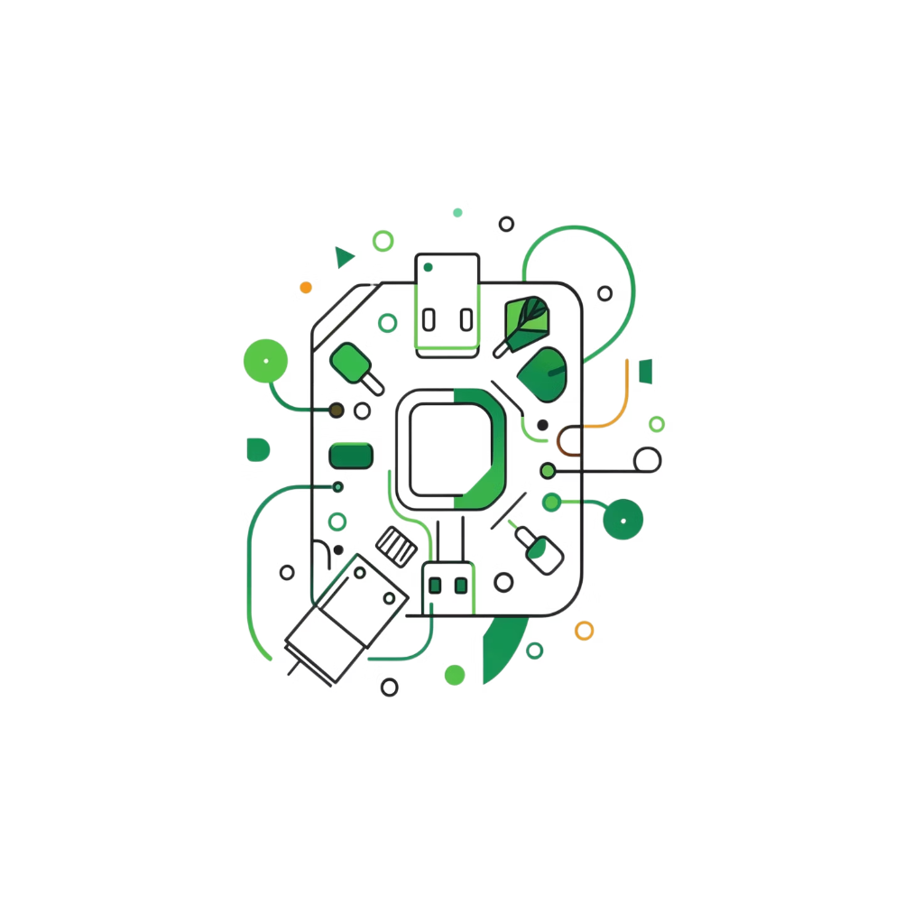
What Makes This Board Different
All-in-One Design
Integrated Battery + Charging
MCU, power regulation, and battery charging on one board — no external modules.
Li-Ion cell connects directly; charging is handled onboard via USB.
Efficient Power Management
Compact & Portable
DC-DC conversion minimizes losses compared to linear regulator chains.
2-layer PCB keeps the footprint small enough for product enclosures.

Slide 11
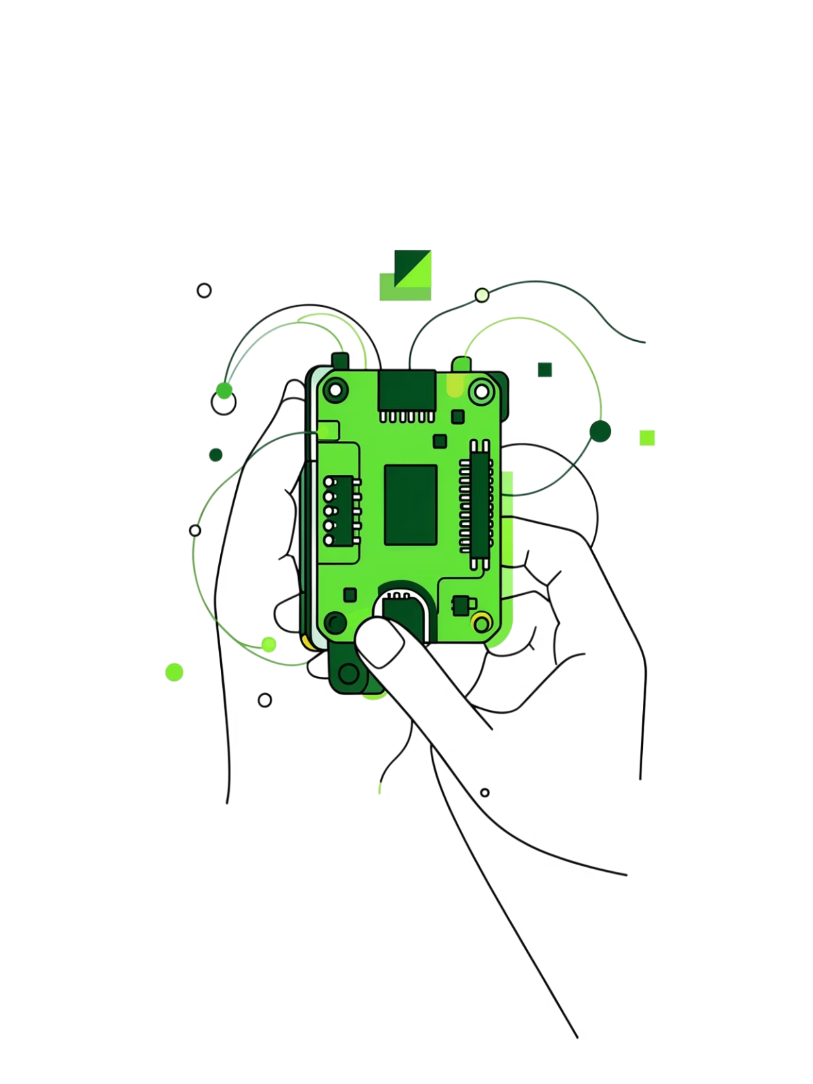
Conclusion
This custom STM32 board bridges the gap between rapid prototyping and product deployment — delivering an integrated, battery-ready embedded solution in a compact form factor.
Compact
Integrated
2-layer PCB, minimal footprint
Power + charging onboard
Product-Ready
Built for real-world deployment

